Slide 1
Sweetlicious
Team Members:
Sreeja Ulligadda 11721337
Bhavya Golla 11708064
Hemalatha Chitra 11705522
Swetha Tejaswini Manda 11702198
Aishwarya Yadav jala 11607930
Neelesh Bagal 11618665

Slide 2
Contents:
Intro and objective
Methodology
Project Scope and Design
Flow Chart
Multifactor Authentication and Payment Gateway
Security Features Applied
Results
Conclusion

Slide 3
Intro and objective:
Introduction:
We designed a website named Sweetilicious, an e-commerce platform dedicated to handcrafted confectionery and savoury delights.
Objective:
Developed to connect talented chefs with a wider audience, our project aims to satisfy the growing demand for homemade goods.
With robust security features including SSL, MFA, and protection against SQL injection, we ensure a safe and seamless shopping experience.
We have developed this website to bridge the e-commerce gap and empowering artisans to showcase their culinary talents.

Slide 4
Methodology:
Front end: Html, CSS, JavaScript and Ajax
Back end: python Django framework(Model Template View Methodology)
Database : SQLite.

Slide 5
Project Scope and Design:
User Registration
User login
Bakery items Listings
Product Details
Search bar
Notifications/Alerts
Wish list
Cart
Checkout Process

Slide 6
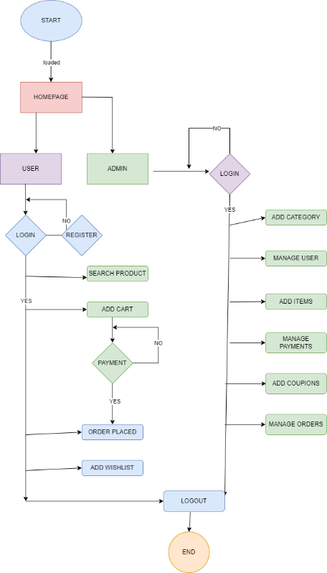
Flow Chart:

Slide 7
Multifactor Authentication and Payment Gateway:
MFA:
Time –based OTP Authentication: The user must scan the QR code provided by the google authenticator, which results a time –based OTP in the device that is valid for 30 secs.
Security Backup code: Users can store the any code from the list of backup codes and can later use while signing in to the website.
Payment Gateway(Stripe):
Stripe accepts different payment methods, including credit cards, debit cards, providing flexibility to customers.
For payment authentication and to ensure that a valid user is trying to payment we send them a mail with the purchase option to ensure security.

Slide 8
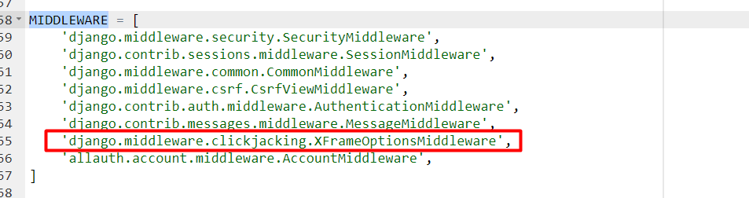
Security Features Applied:
Middleware:
Clickjacking: This prevents the site from rendering an inside frame.

Slide 9
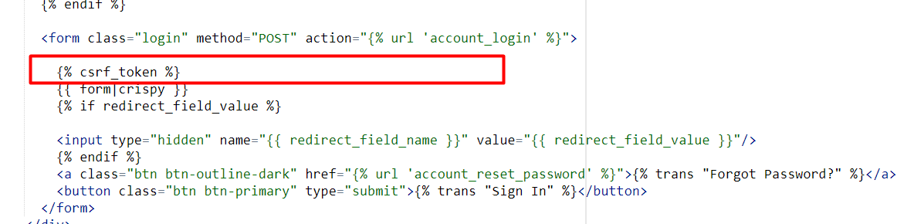
Continuation..
Cross site request forgery (CSRF) protection:
This prevents cross site scripting by providing tokens to each form thus checking that the source is the same and hasn’t changed.

Slide 10
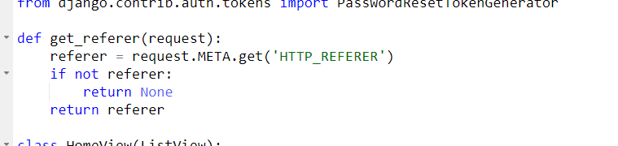
Continuation..
URL Injection prevention:
This prevents user from accessing the page directly through the URL.

Slide 11
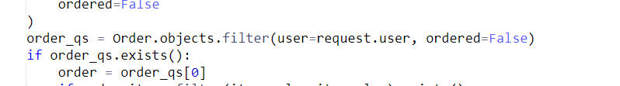
Continuation..
SQL injection:
SQL injection in Django is prevented by various means:
ORM (Object-Relational Mapping) Prevents writing queries to access database.

Slide 12
Continuation..
SQL injection:
Automatic Escaping: This applies jinja format the use of {{}} to fetch the data.

Slide 13
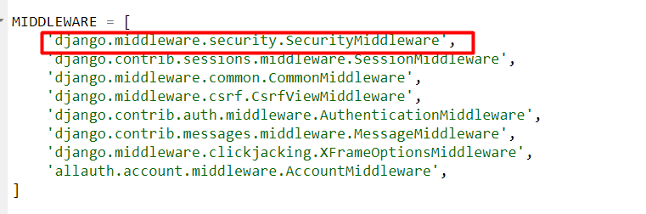
Continuation..
SQL injection:
Security Middleware

Slide 14
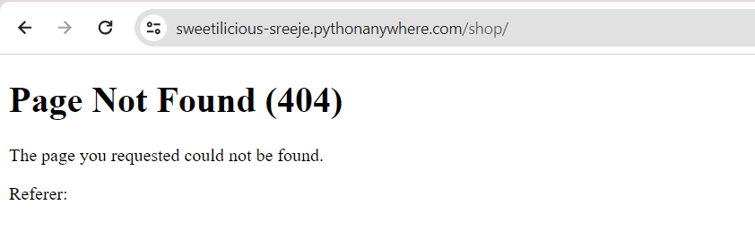
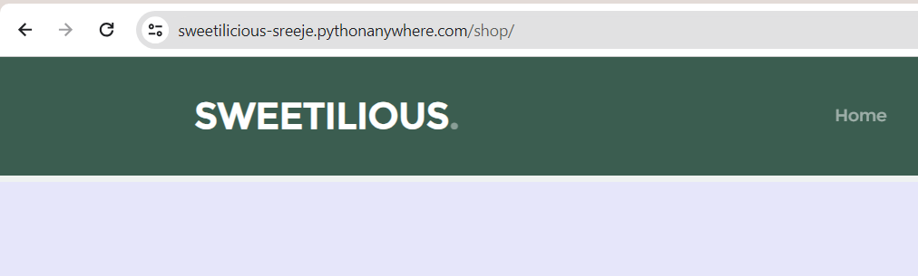
Continuation.. URL Injection prevention:
Testing with the shop page.
With correct button clicked.

Slide 15
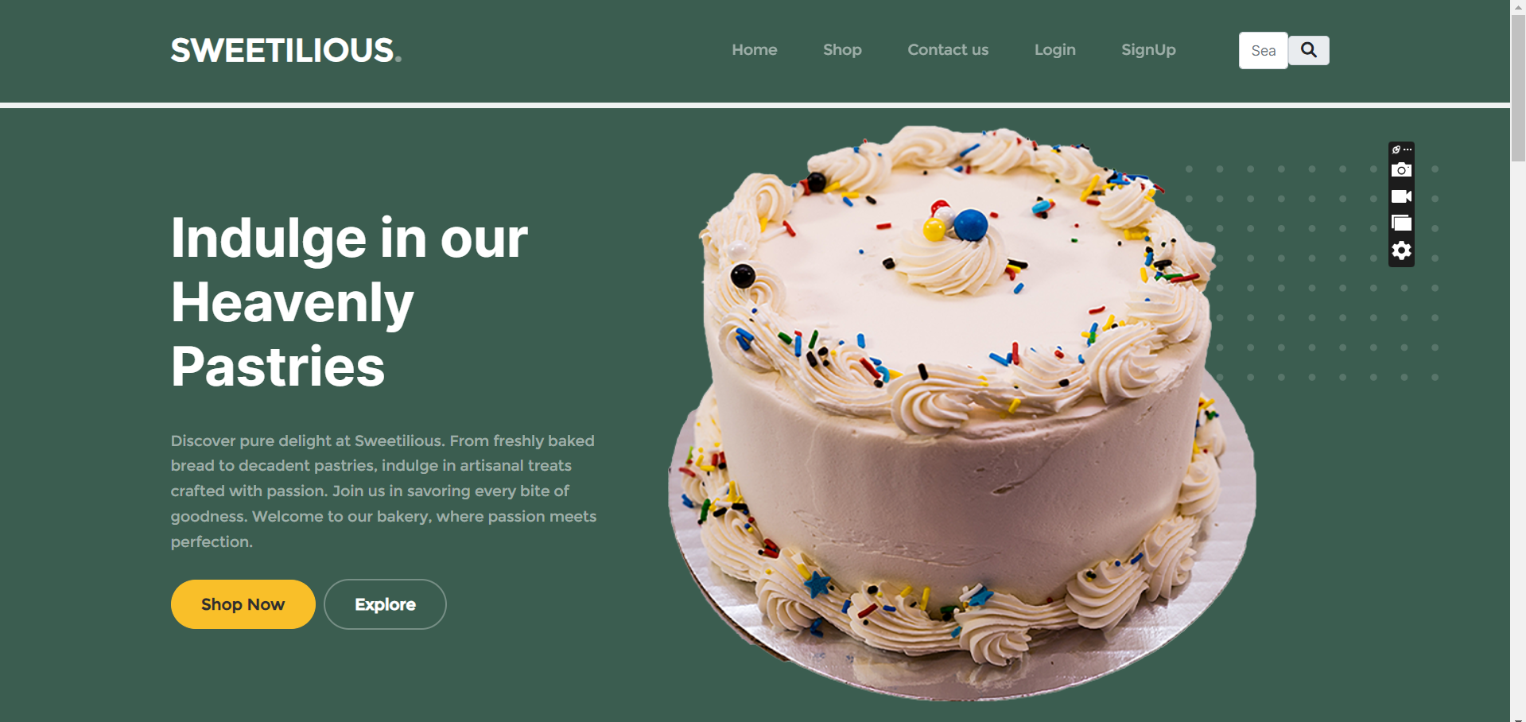
Results:
Homepage.

Slide 16
Conclusion:
The comprehensive security features implemented in the project ensure a robust defense against various common web vulnerabilities, including URL injection, SQL injection, cross-site request forgery (CSRF), and clickjacking. These measures aim to safeguard user data, transactions, and overall site integrity.
By prioritizing security alongside user experience and functionality, the project not only creates a safe environment for users to browse and purchase handcrafted confectionery and savory food but also underscores the commitment to providing a trustworthy and reliable e-commerce platform for both buyers and sellers.

Slide 17
Thank you

